Slide 1
2006 Plans Discussion
Gap Strategic Overview

Slide 2
Executive Summary
Gap struggling with Retail 2010 issues
The Gap is experiencing a 2010 identity crisis: Mass and luxury retailers continue to see growth (Target at 6.3% and Nordstrom 6.1% YTD Comps) while the middle is squeezed. September ’05 YTD comps for The Gap Inc. are - 5.0%
Specialty apparel as whole has experienced lack lustre performance with negative and mostly flat comps with both The Limited and Ann Taylor at -3.0%. However, A&F at 24.0%and AEO at 20.1%continue to post strong numbers by focusing on the young adult market .
2005 has seen a retrenchment in BCS revenue and profit and IBM overall revenues
2004 was a high watermark for BCS ($16M) and IBM (+/- $100M) during which several major projects were completed (Oracle, PFI integration, BCS; POS Rollout RSS/ITS), and key BCS project losses sustained (PLM, HR)
In 2005 Gap Direct $_______ (multi-channel solutions) has been the strongest BCS revenue stream Total 2005 BCS $_____ (projected)
MDS project related write down of 1.8M has caused account profitability to suffer
2005 has opened new windows of opportunity
IBM and Gap have begun due diligence around infrastructure outsourcing and joint review of select BTO opportunities
2006 BCS focus will be selling core retail solutions, BTO drag and select BCS opportunities
….
….
Success Factors for 2006
Ability to win Core Merchandising System work away from Accenture
Continue to deliver and expand on the Gap Direct relationship

Slide 3
Buying Environment
Gap Strategic Priorities:
International expansion
Cost management: Infrastructure modernization
Business Capability Improvement: Core merchant application transformation
Competitive Landscape Footprint:
Accenture continues to be the partner of choice for merchandising systems integration.
Bearing Point (HR) & CGEY(PLM) have made some competitive inroads
IBM Footprint, Solutions Focus, and Opportunity Areas:
Currently engaged: AIS support for application integration and AIS support for multi-channel application development
Investigate opportunities to drive business in store systems

Slide 4
Buying Environment
Critical Client Relationships Dedicated IBM Resource Needs:
Senior Executive commitment to GAP
…
…
Global Account Team
Patrick O'Donnell
Michael Ziegler
Michael Mcglinchey
BCS Team
Whitney Walker
Kelly Chambliss
Steve Luce
Larry Salmela

Slide 5
Client Development Objectives/Strategy
Provide key 2006 objectives and the strategy(ies) for capitalizing on priority business opportunity areas including how we will be competitively differentiated and our initial thoughts on how we optimize client benefits and value, as well as profitability/value to BCS/IBM.
  Prepare to discuss leveraging prior work
  Preempting/blocking out competition
  Resource requirements/allocation plan
  Investment opportunities
  Cross service or LOB integration
  Risks and potential barriers to success
Question for Pat O: Does IBM envision selling BCS thru the outsourcing contract in 2006 if Brooklyn succeeds?

Slide 6
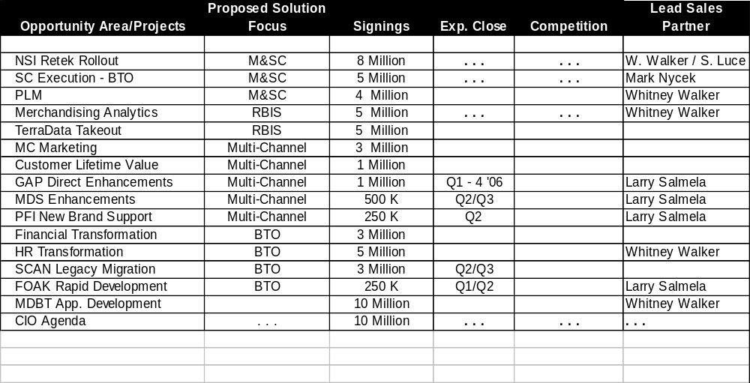
Opportunity Area/Solutions Roadmap

Slide 7
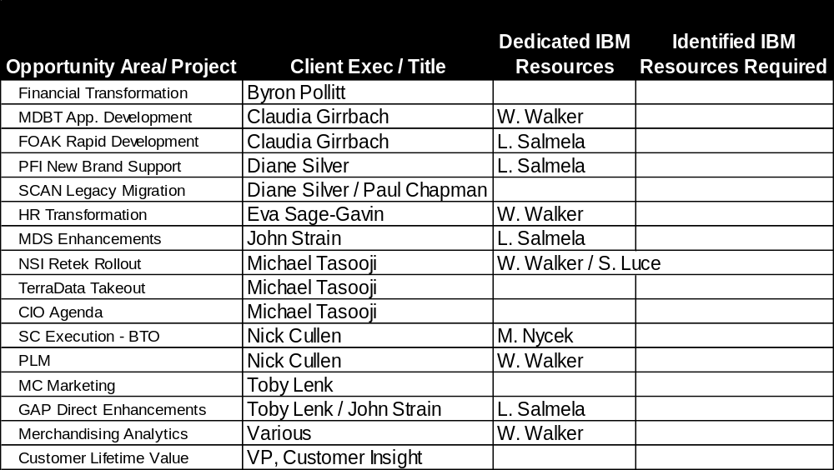
Resource Alignment and Allocation Map

Slide 8
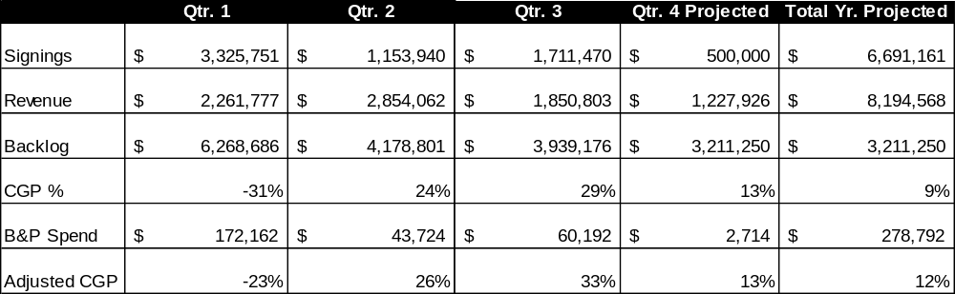
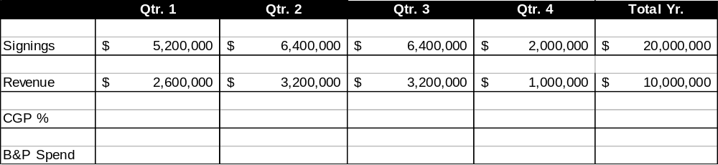
2006 Business Metrics
2005 Performance (YTD/Projected)
2006 Targets

Slide 9
Issues, Concerns
Summary of those issues and potential problem areas where we may need additional help and must be prepared to address if we are to achieve our goals this coming year.

